Slide 1
The 3 R’s of Gender Equity
Merry L. Lindsey, Ph.D.
林曼丽
メリー リンゼイ
메리 린지
Professor, Department of Physiology
Research Health Scientist, G.V. (Sonny) Montgomery VA

Slide 2
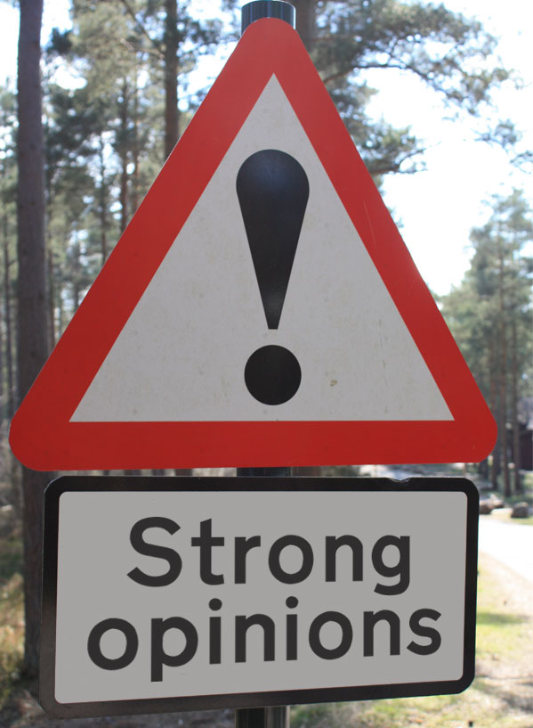
Disclosure
My views are my own, based on reading and my own experiences & observations.
You may or may not agree with everything I say.
That is ok.
http://www.abccopywriting.com/2012/03/12/25-great-twitter-disclaimers

Slide 3
3 R’s
Recognition
Responsibility
Resilience
Comments also apply to race, creed, disability equity

Slide 4
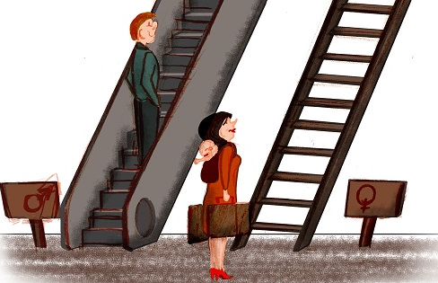
Recognition
Gender equity- ideal situation
Inequity exists
The UN Shows The Reality Of Gender Inequality With Clever Illustrations
http://henryaquino.com/the-un-shows-the-reality-of-gender-inequality-with-clever-illustrations/

Slide 5
Gender inequality
Unequal treatment or perceptions of individuals based on gender.
Arises from differences in socially constructed gender roles.
-Wikipedia
Man- boss, head, chair, science, math- blue
brilliance
Woman- wife, mother, volunteer, arts- pink

Slide 6
At Home
Gender equality begins at home: empty the dishwasher, guys- Judith Ireland
women around the globe do ~2.5x more unpaid work
Pakistan: 10x
Guatemala: 5x
Australia: 311 min unpaid work/ day (vs. 172)
Unpaid home work → ↓ economic security
http://www.smh.com.au/comment/gender-equality-begins-at-home-empty-the-dishwasher-guys-20150430-1mxa62.html

Slide 7
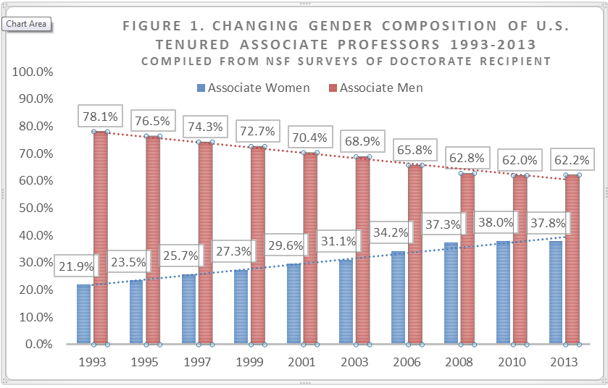
In Academic Medicine
https://www.insidehighered.com/advice/2015/07/20/essay-calls-new-metaphor-clogged-pipeline-academic-workforce

Slide 8
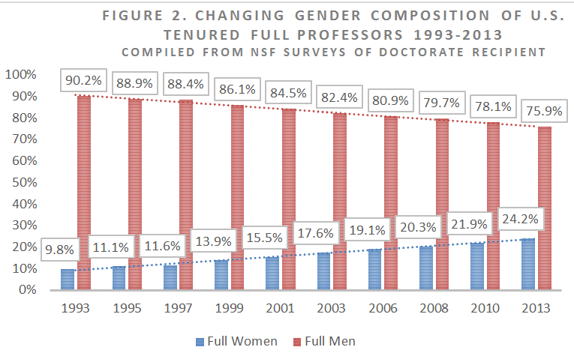
Gets worse the higher up you go

Slide 9
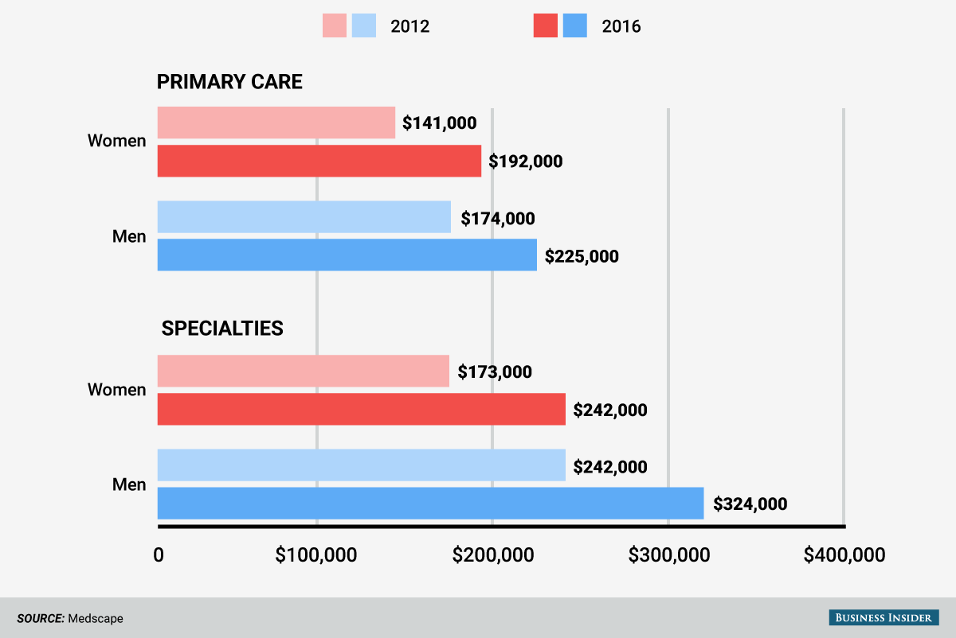
In Physician Salary

Slide 10
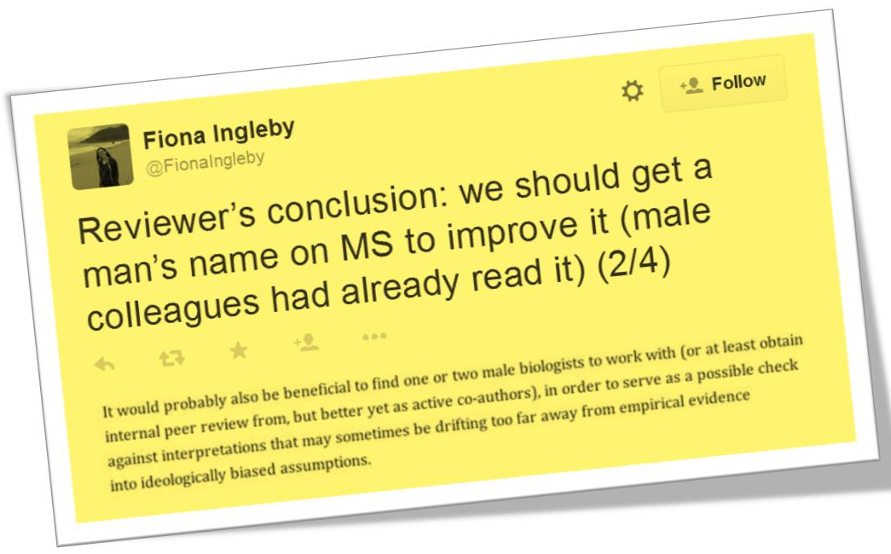
In Peer Review
PLOS One article review in 2015

Slide 11
The Role of Gender in Scholarly Authorship
a large-scale analysis of > 8M articles
women are significantly underrepresented as authors of single-authored papers.
Author position
Last
PLoS One. 2013; 8(7): e66212.

Slide 12
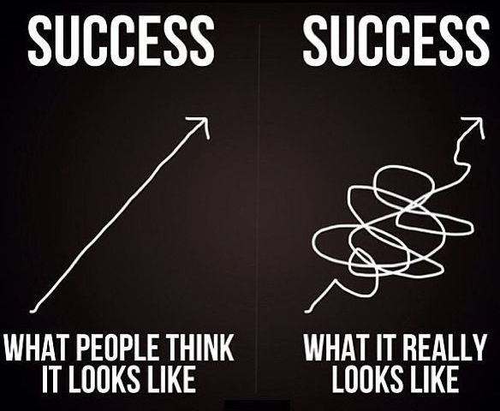
Do not be discouraged
Being
3-4x
better
is
EASY.
https://www.pinterest.com/explore/discouraged-quotes/

Slide 13
Excuses- Women are not:
Smart- don’t have science ability
Interested in science
Willing to devote the time required to have expertise/ leadership skills
Willing to spend time away from their families
Encouraged to develop scientific interest.
Favored in hiring and promotion (conscious & subconscious bias)
Excuses are not SOLUTIONS

Slide 14
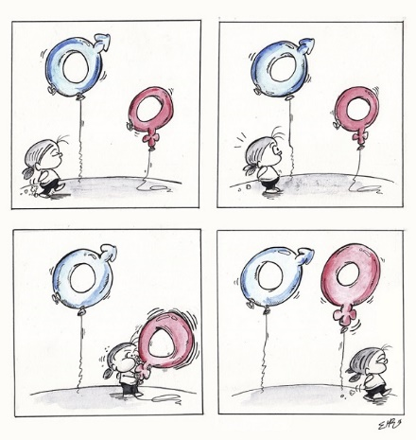
Responsibility
To be part of
the solution
Emilio Morales Ruiz, Spain: “…Even the smallest acts are important steps for solving this global problem.”

Slide 15
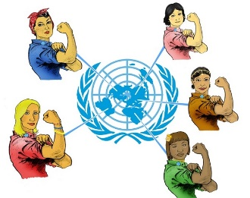
Aleksi Siirtola, Finland: “My picture depicts how women can work toward equality without compromising who they are. The goal of equality is universal.”
http://henryaquino.com/the-un-shows-the-reality-of-gender-inequality-with-clever-illustrations/

Slide 16
Helping our voices be heard
Use Amplification
repeat an idea of a female colleague & give her credit for the idea by name
Validates that we have power & control to effect change
Encourages us to harness our own power
Remind us that it’s crucial to help each other
http://www.thedailybeast.com/articles/2016/09/23/how-the-women-of-the-obama-white-house-fought-gender-inequality-and-we-can-too.html

Slide 17
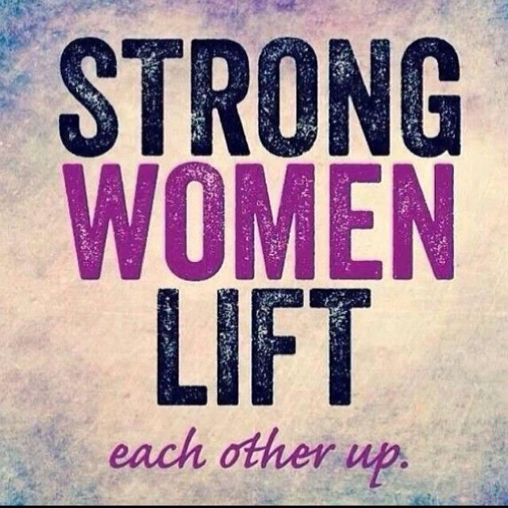
This does not mean you only help or never help
https://www.pinterest.com/fonlaughlin/dcwl-stuff/

Slide 18
3 Reasons Why Women Don’t Help Other Women
To show they are part of the team/ the men’s club
To avoid subtle/ not subtle disapproval from their male peers
Women helping women is not valued work:
men coming together- networking (business-related)
women coming together- congregating (socializing)
men helping men- sponsorship & succession planning
women helping women- feminism
http://www.huffingtonpost.com/carol-vallone-mitchell/3-reasons-why-women-dont-help-other-women_b_9306330.html

Slide 19
What works in a gender-biased world
Meaning
define your success
Framing
be positive in outlook
Connecting
establish a few deep & a lot of superficial connections
Energizing
maximize activities that energize you
Engaging
speak up, lean in, ask for what you want
http://gender.stanford.edu/news/2014/women%E2%80%99s-leadership-what-really-works-gender-biased-world

Slide 20
Action Items
Know what you want; map a plan to get it
Develop mentoring system- above, peer, below
Actively support the cause
Examples:
Pay attention at committee meetings
Recommend women speakers for grand rounds, seminars, national meeting programs- submit ideas
Volunteer for inclusion (editorials)

Slide 21
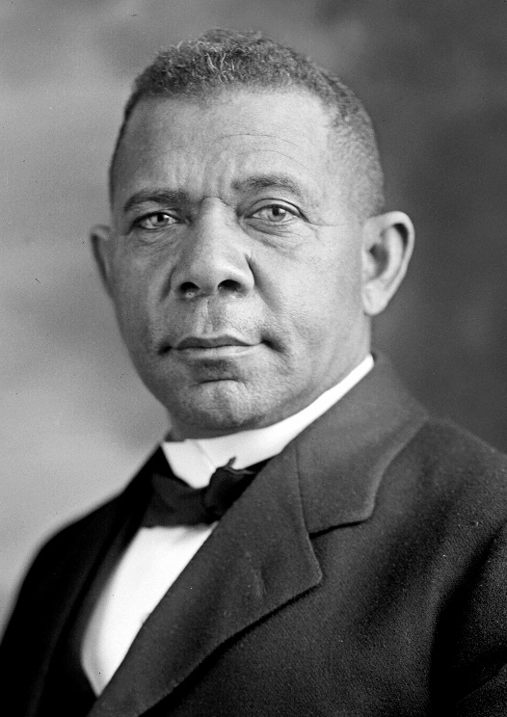
There are two ways of exerting one's strength: One is pushing down, the other is pulling up. -Booker T. Washington, writer, educator and orator

